Slide 1


A.P. MOLLER - MAERSK
University of Copenhagen – Blockchain Summer School - 2017
Indirect taxation process/ VAT processing

Slide 2

The status-quo too inefficient to fulfill the needs of $13.4bn-VAT under management
Data integration
ERP
Accounting
Tax Reporting
Contract
B/L
VAT
ERP
100
1000
Mapping: Input data to output
Extraction: Manual extraction of input data
Submission: Reporting to auditing agency
Human error
Data errors
Audit contingency

Slide 3
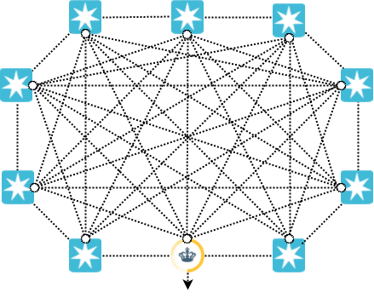
Combining blockchain technology with a decentralized and immutable data storage yields a high level of data consistency and traceability
Modular design
Immutable, data storage with versioning
Secure end-to-end audit trail, retraceable to single transactions
Include external stakeholders
Proactively mitigating future compliance issues in auditing

Slide 4
How it is done...
Data processing
Hash (H_{New-1})
IPFS
Upload data
Hash (H_{New})
Initial data
Hash (H_{Mom})
Node
Ethereum
Timestamp
Hash (H_{New}) → Transaction
Data
retrieval
IPFS
Hash (H_{Final-1})
Hash (H_{Final-2})
Hash (H_{Final})
Hash (H_{Mom})
Hash (H_{Mom})
File.xls
File.xls
File.pdf ...
File.pdf ...
Address: Hash (H_{Mom})
Address: Hash (H_{Mom})
Ethereum
Transaction: Hash (H_{Final-1})
Transaction: Hash (H_{Final-2})
Timestamp
Timestamp

Slide 5
Demo time

Slide 6
Perspectives
Moving towards a decentralized database
Enforcing data consistency
Enabling organizational transparency
Adding smart contract functionalities
Automated integration of ERP systems in auditing
Decreasing fixed costs
Developing new business models
Building platform ecosystems
Driving new business standards

Slide 7
Thank you
Stefan Seebacher – Eric Holst
Visa Vallivaara – Lorenzo Setale

Slide 8
Combining blockchain technology with a decentralized and immutable data storage yields a high level of data consistency and traceability
Data processing
Hash (H_{New-1})
IPFS
Upload data
Hash (H_{New})
Initial data
Hash (H_{Mom})
Node
Ethereum
Timestamp
Hash (H_{New}) → Transaction
Data
retrieval
IPFS
Hash (H_{Final-1})
Hash (H_{Final-2})
Hash (H_{Final})
Hash (H_{Mom})
Hash (H_{Mom})
File.xls
File.xls
File.pdf ...
File.pdf ...
Address: Hash (H_{Mom})
Address: Hash (H_{Mom})
Ethereum
Transaction: Hash (H_{Final-1})
Transaction: Hash (H_{Final-2})
Timestamp
Timestamp

Slide 9
End-to-end audit trail: Data processing steps have to be recorded and securely saved as well as data needs to be accessible for relevant parties
Option | 1 | 2 | 3 | 4
Data verification | Blockchain | Blockchain | Blockchain | Blockchain
Data storage | Blockchain | Centralized storage | Decentralized storage | Decentralized & immutable storage
Secure solution
Low throughput
Expensive storage
Verification of data is securely stored
Storage as single point of failure
Verification of data is securely stored
Data can be manipulated
Verification of data is securely stored
Secure and immutable data storage

Slide 10
Combining blockchain technology with a decentralized and immutable data storage yields a high level of data consistency and traceablity
Data processing
Hash (H_{New-1})
IPFS
Upload data
Hash (H_{New})
Initial data
Hash (H_{Mom})
Node
Ethereum
Timestamp
Hash (H_{New}) → Transaction
Data
retrieval
IPFS
Hash (H_{Final-1})
Hash (H_{Final-2})
Hash (H_{Final})
Hash (H_{Mom})
Hash (H_{Mom})
File.xls
File.xls
File.pdf ...
File.pdf ...
Address: Hash (H_{Mom})
Address: Hash (H_{Mom})
Ethereum
Transaction: Hash (H_{Final-1})
Transaction: Hash (H_{Final-2})
Timestamp
Timestamp

Slide 11
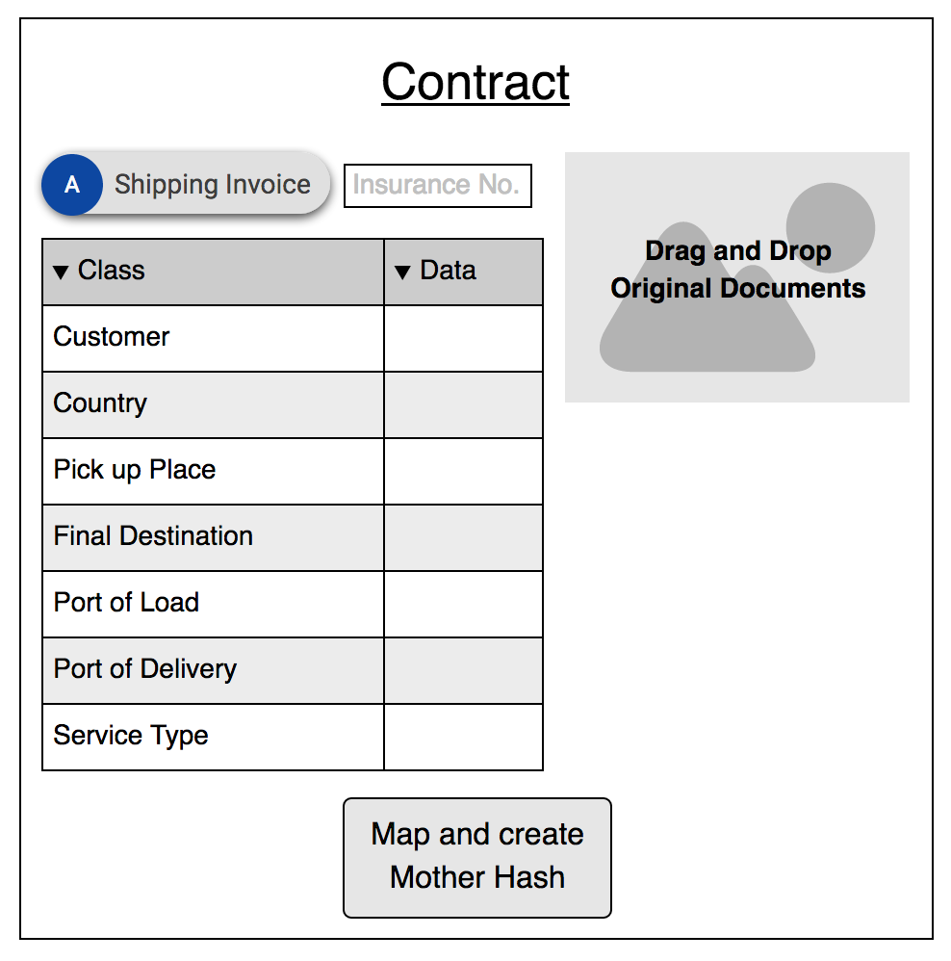
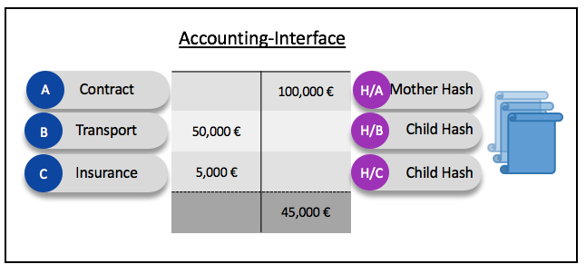
Backup FlowChart mit Mockups-Gefühl
ERP
Tax-Cockpit

Slide 13
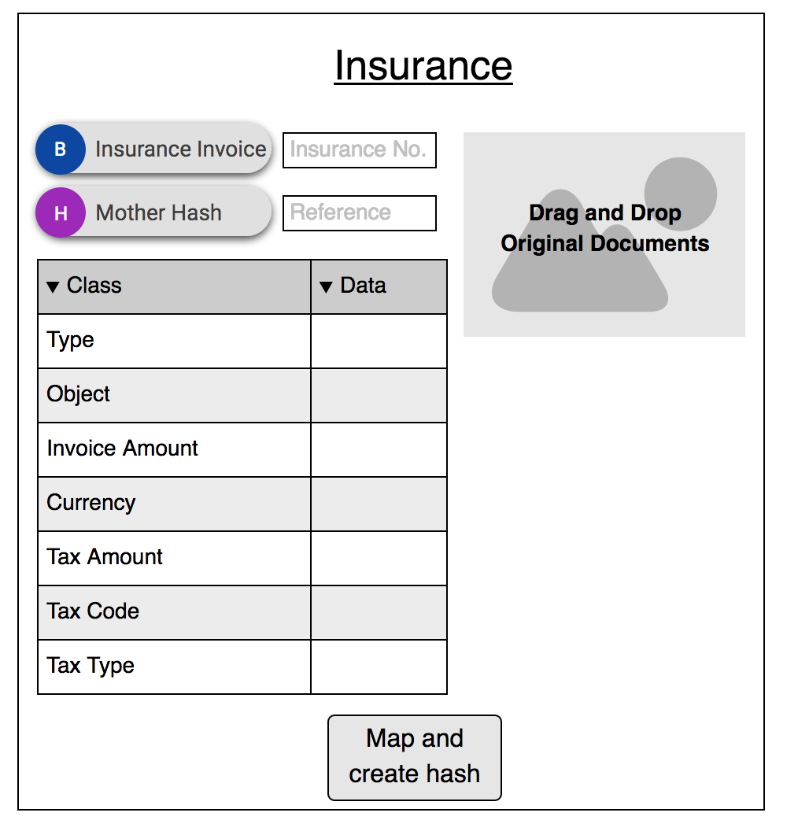

Slide 14
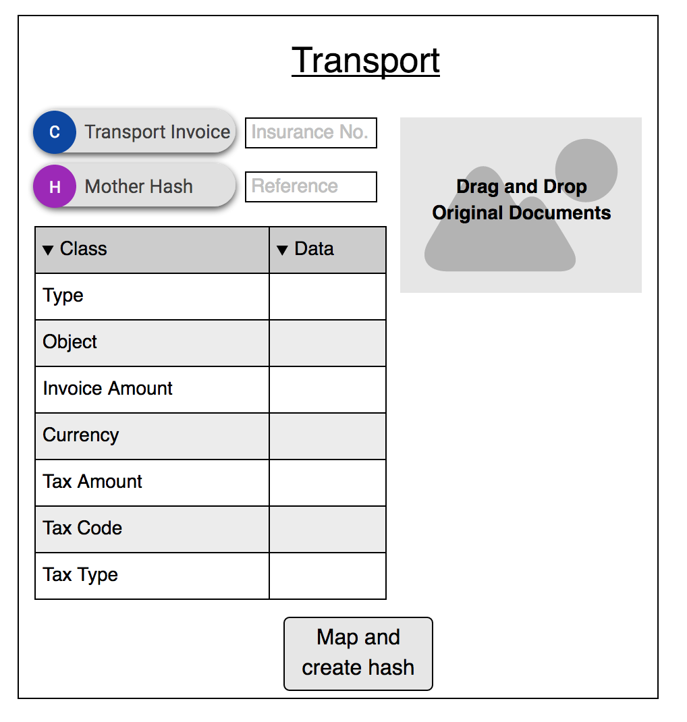

Slide 15
Accounting-Interface
Contract
 | 100,000 €
50,000 €
5,000 €
 | 45,000 €
Mother Hash
A
H/A
Transport
Child Hash
B
H/B
Insurance
Child Hash
C
H/C

Slide 16
Tax-Cockpit
Contract
 | 100,000 €
50,000 €
5,000 €
 | 45,000 €
Mother Hash
A
H/A
Transport
Child Hash
B
H/B
Insurance
Child Hash
C
H/C

